Slide 1

Mini Project: Laptop Stand
By: Gabriel Benitez

Slide 2
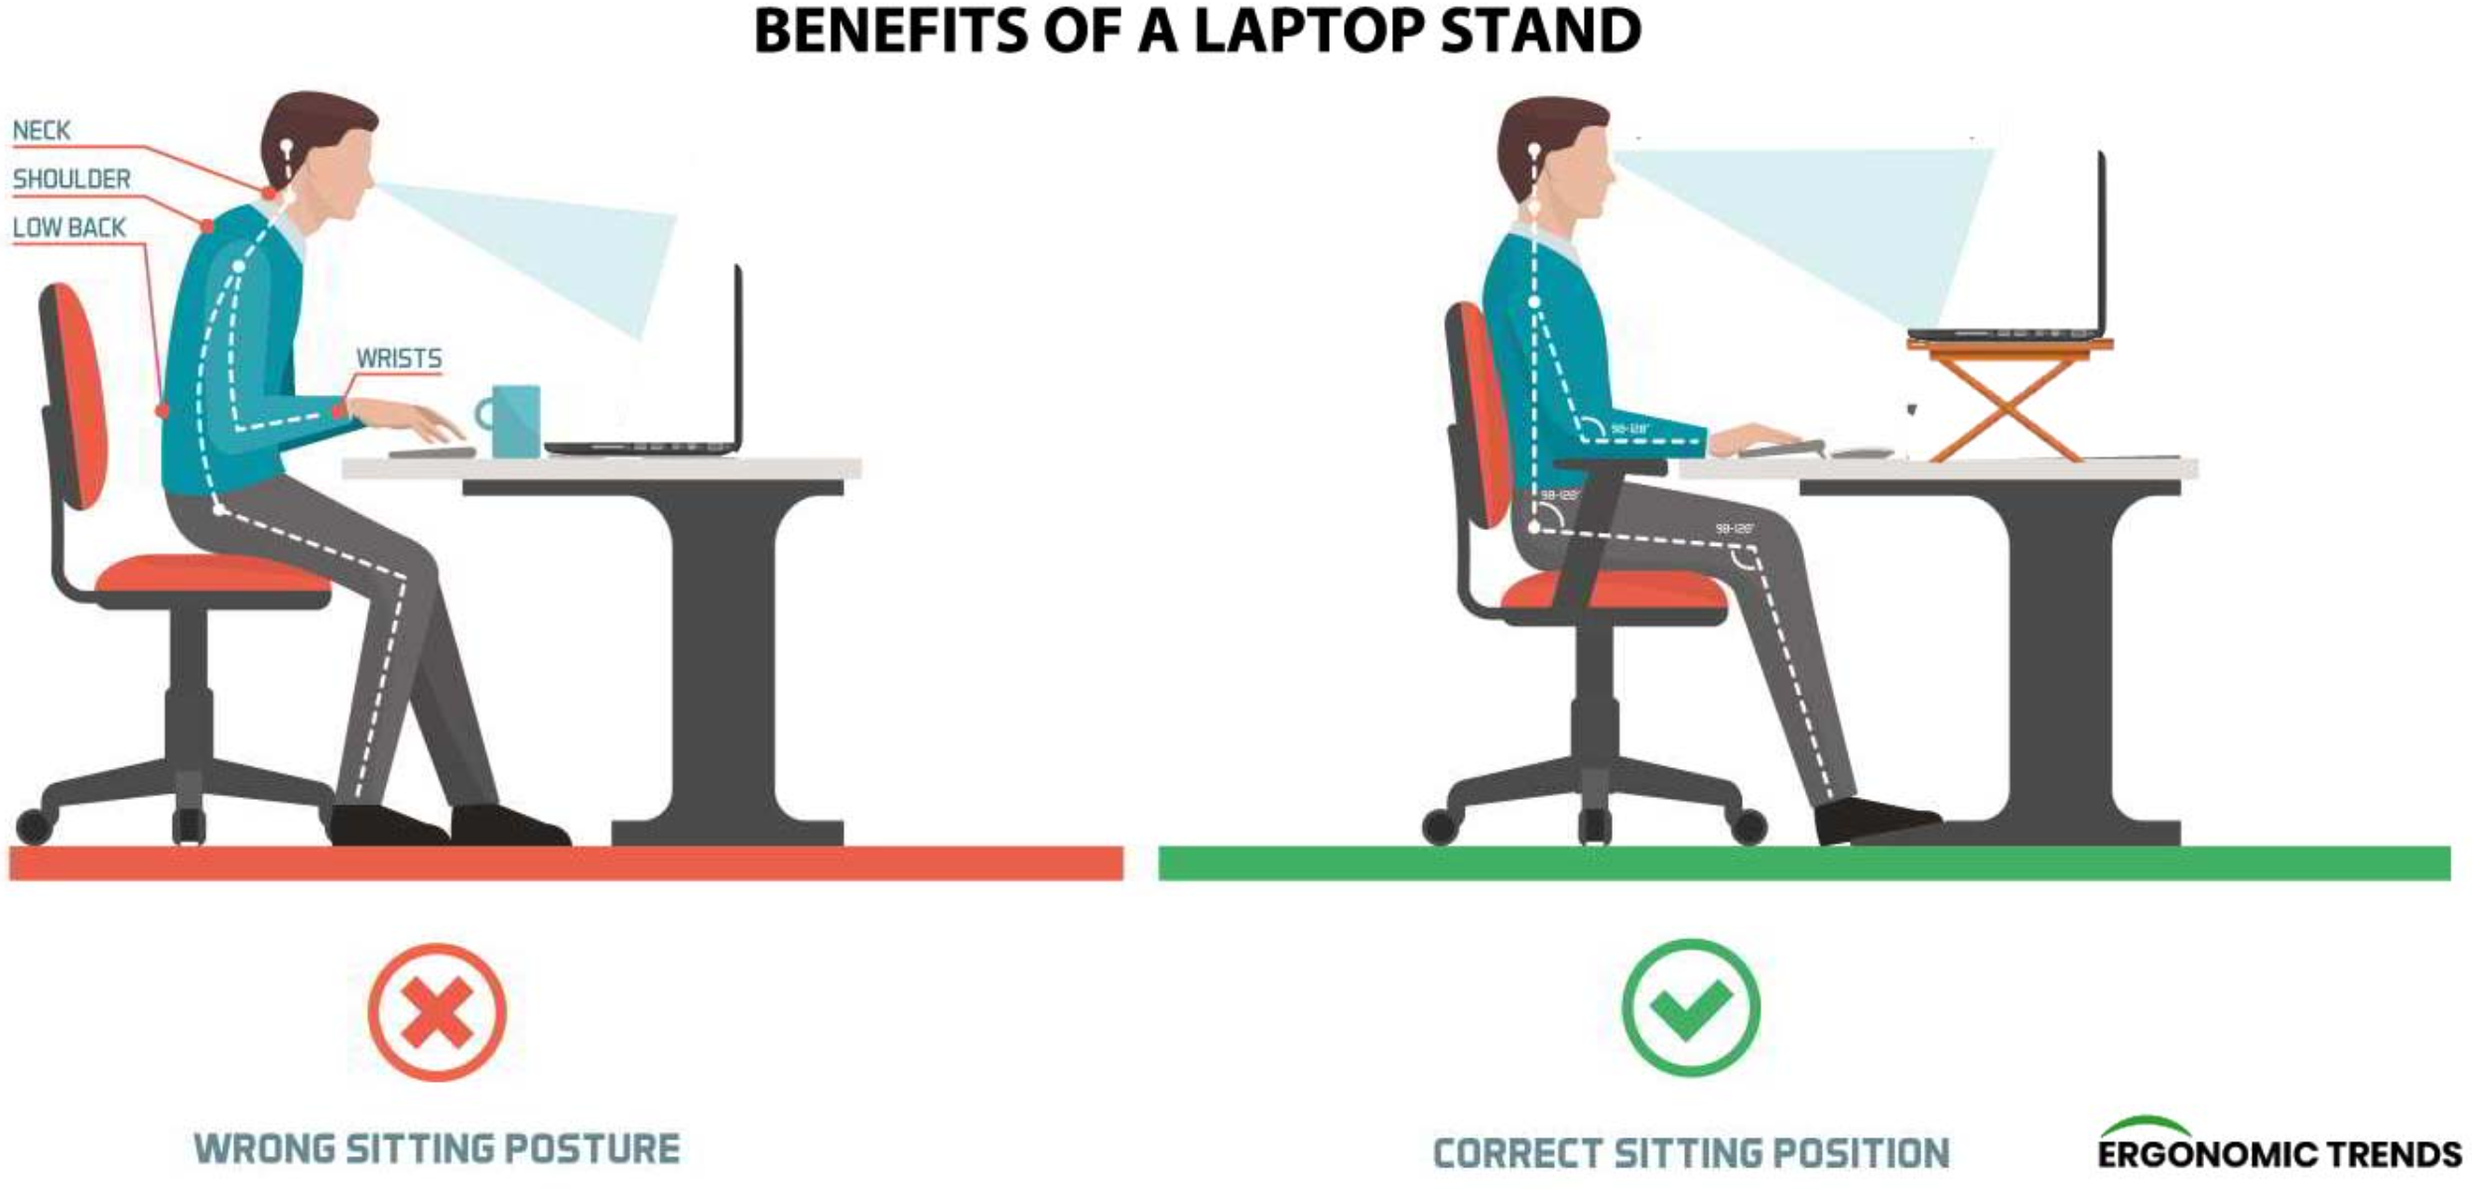
Overview
Aid the work from home, or school from home situation
Laptop Stand
Bringing the laptop screen to eye level
Notes:
Benefits are immense from an ergonomic standpoint
Brings laptop screen to eye level
Using a laptop for any extended amount of time usually results in stiffness or pain in your neck and back
Mainly a result of low height of the laptop screen, which forces you to constantly look down to see the screen
Amount of weight on your neck due to the weight of the head increases as the angle increases
http://ergonomictrends.com/ergonomic-benefits-of-laptop-stands/

Slide 3
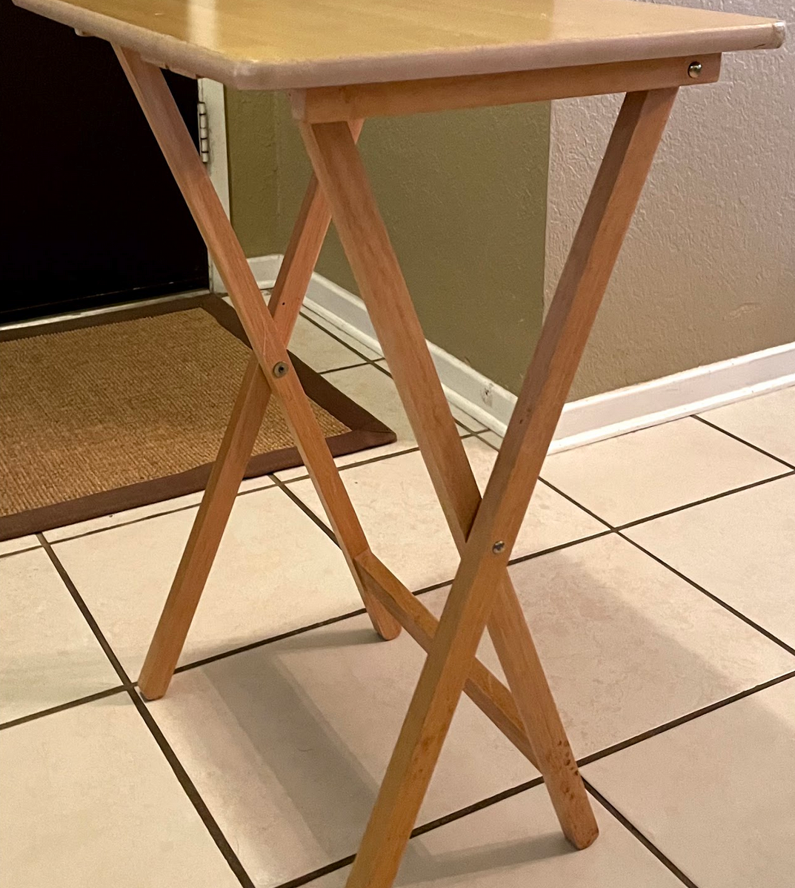
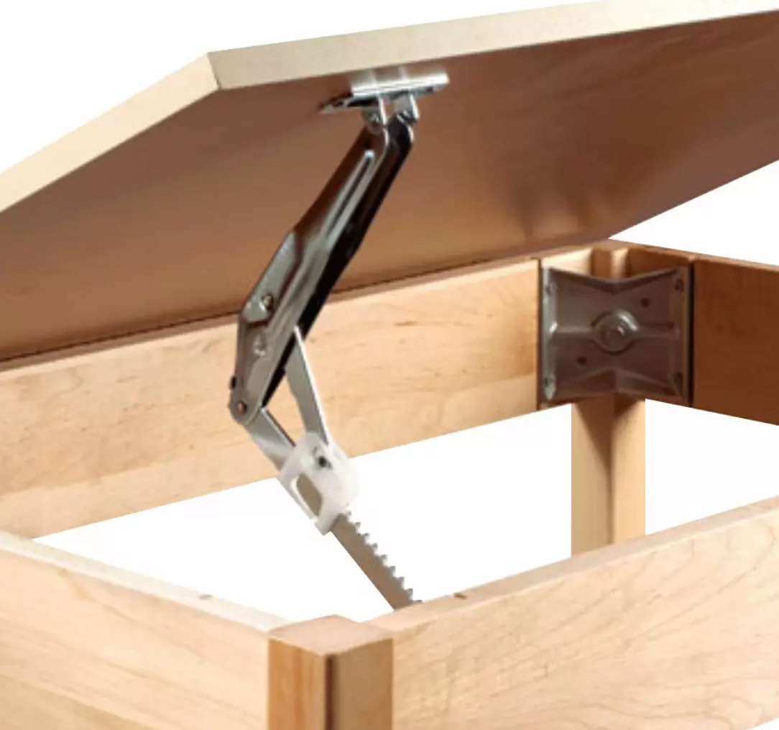
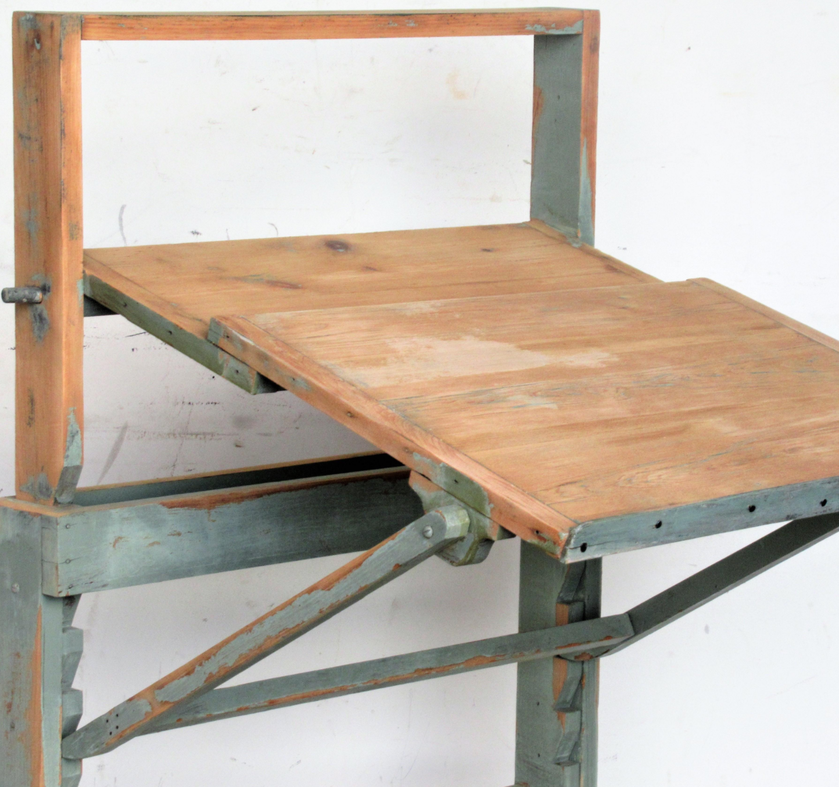
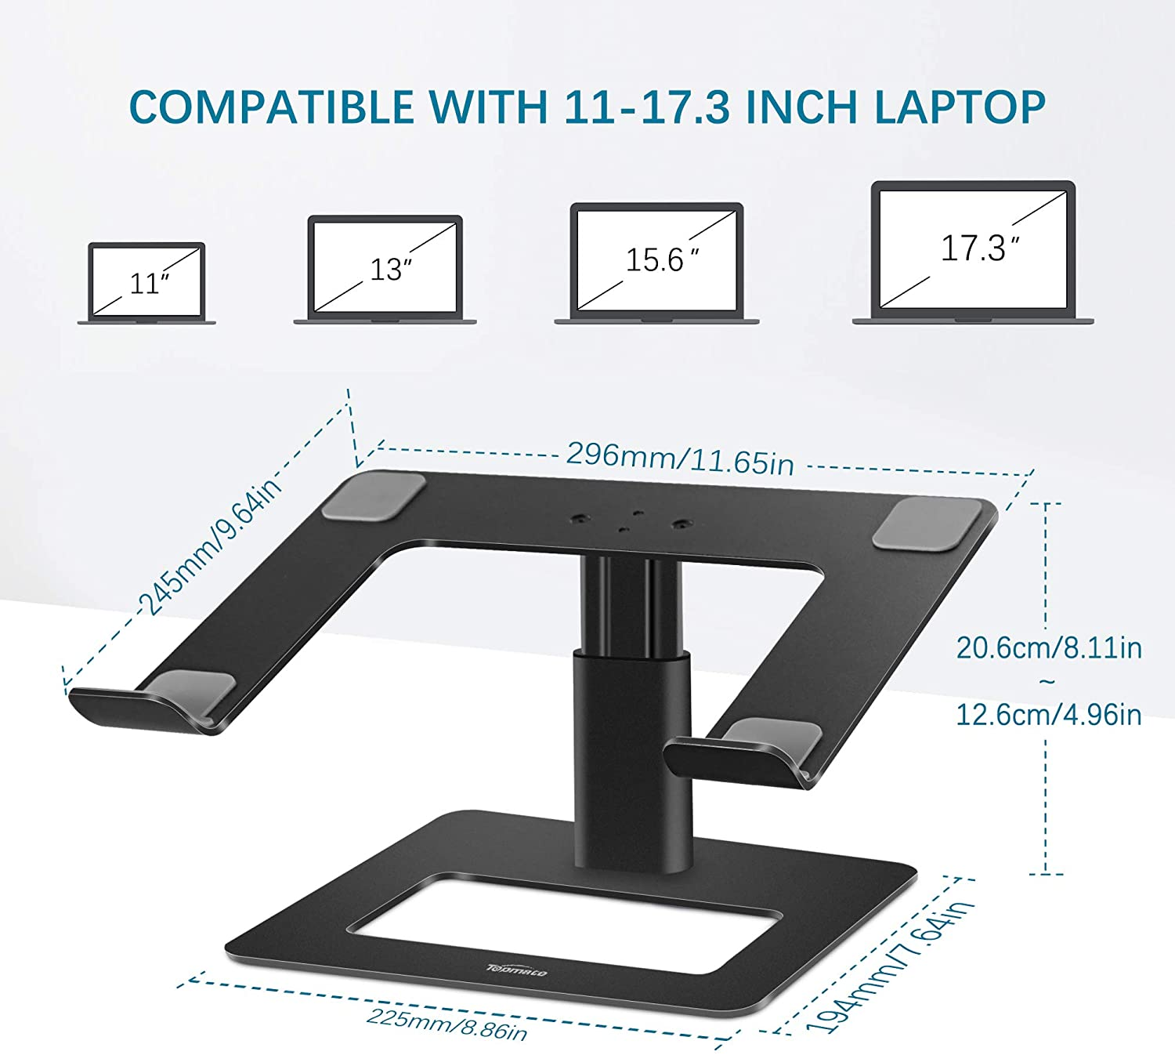
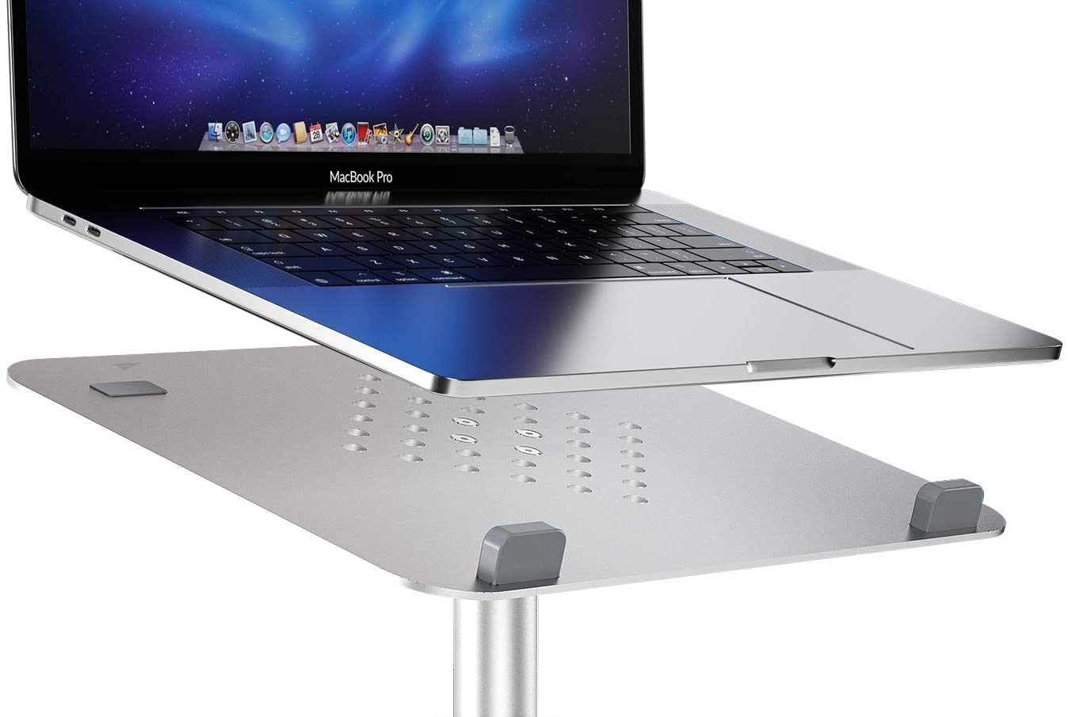
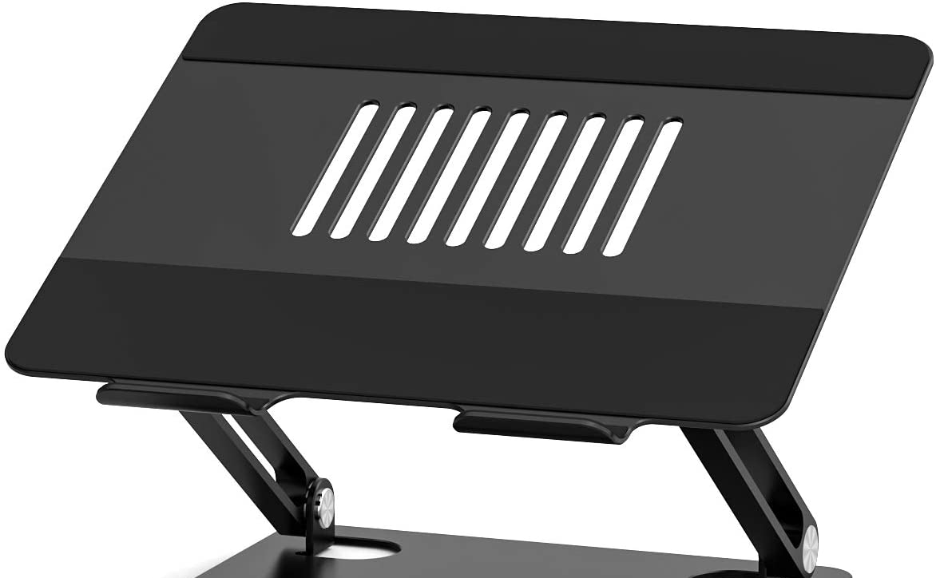
Initial Concept Design
Notes:
Throughout my research I created some pretty rough sketches of how I wanted to design the laptop stand
On the left side,
Top portion
Notice that I was originally thinking about taking a ratchet and using that as the connector
My main concern with this idea was if it was going to be stable enough to hold up the laptop without falling
Bottom portion
Starting to think about making gaps on the base plate and integrate the ratchet idea within the plate itself
Middle page
Left side
My initial ideas of using the TV Tray table
Problem was that the legs couldn’t be the same height, or else it wouldn’t really be adjusted.
Also, thought it wouldn’t be a good design
Right side
What I finally ended up going with as a design
It incorporates the ratchet and adjustable drafting table idea
Similar to drafting table in the sense that it had the teeth or gaps embedded within the design
Similar to ratchet in the sense that it had a small piece or component that adjusted the height by going into different gaps or teeth and was smaller than the other leg
Right side
Measurements that helped design the assembly
Also helped me envision it better by knowing how specific parts would look

Slide 4
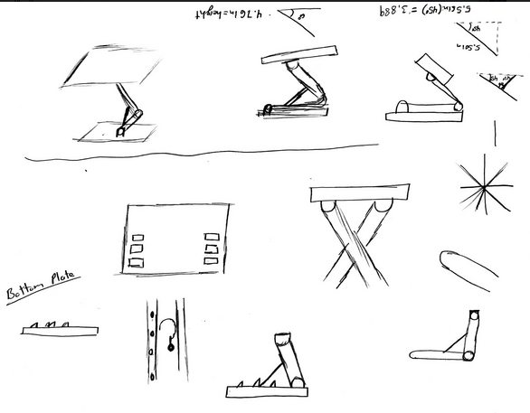
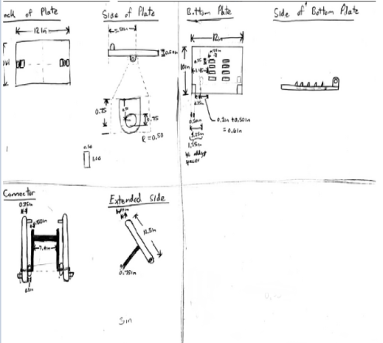
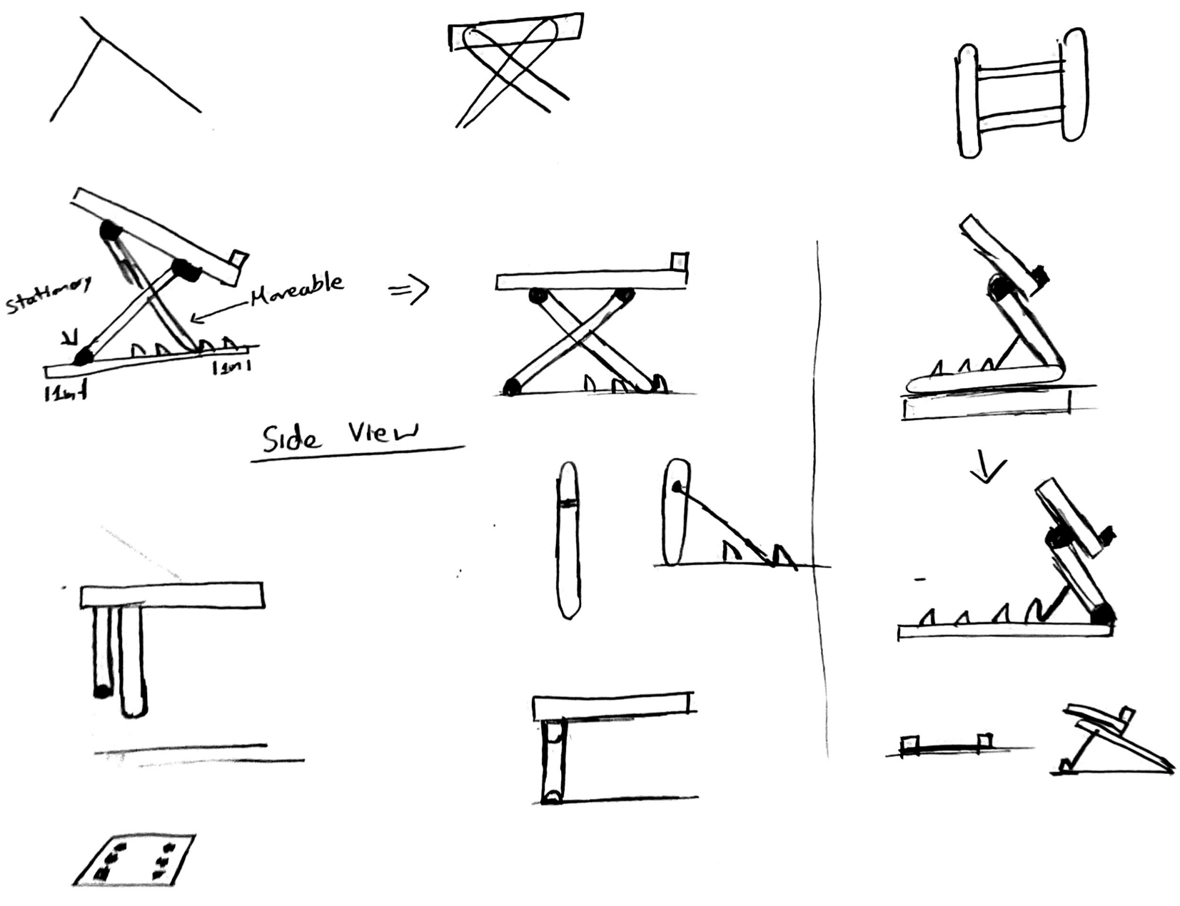
Initial Concept Design
Notes:
Throughout my research I created some pretty rough sketches of how I wanted to design the laptop stand
On the left side,
Top portion
Notice that I was originally thinking about taking a ratchet and using that as the connector
My main concern with this idea was if it was going to be stable enough to hold up the laptop without falling
Bottom portion
Starting to think about making gaps on the base plate and integrate the ratchet idea within the plate itself
Middle page
Left side
My initial ideas of using the TV Tray table
Problem was that the legs couldn’t be the same height, or else it wouldn’t really be adjusted.
Also, thought it wouldn’t be a good design
Right side
What I finally ended up going with as a design
It incorporates the ratchet and adjustable drafting table idea
Similar to drafting table in the sense that it had the teeth or gaps embedded within the design
Similar to ratchet in the sense that it had a small piece or component that adjusted the height by going into different gaps or teeth and was smaller than the other leg
Right side
Measurements that helped design the assembly
Also helped me envision it better by knowing how specific parts would look

Slide 5
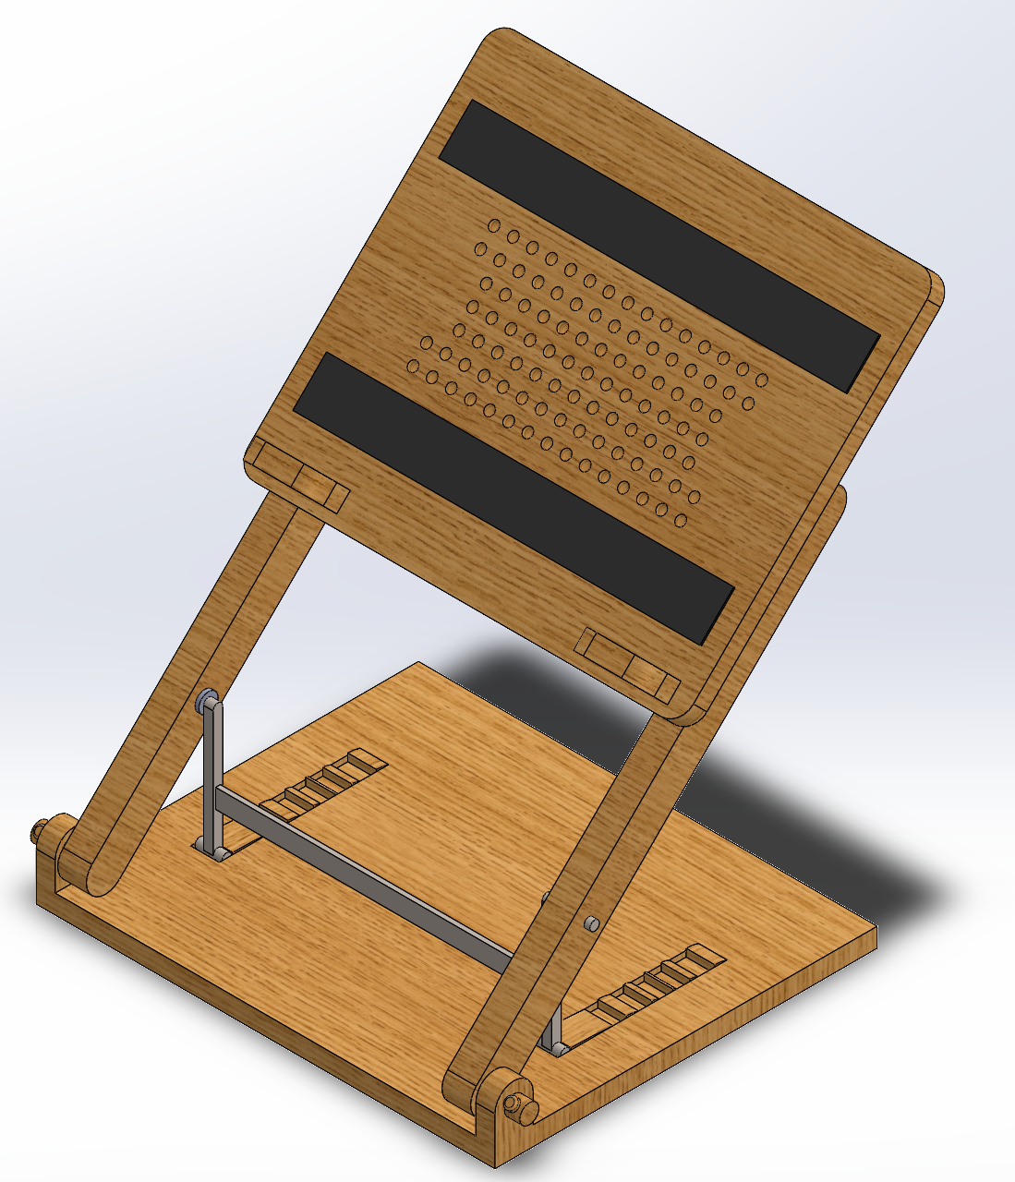
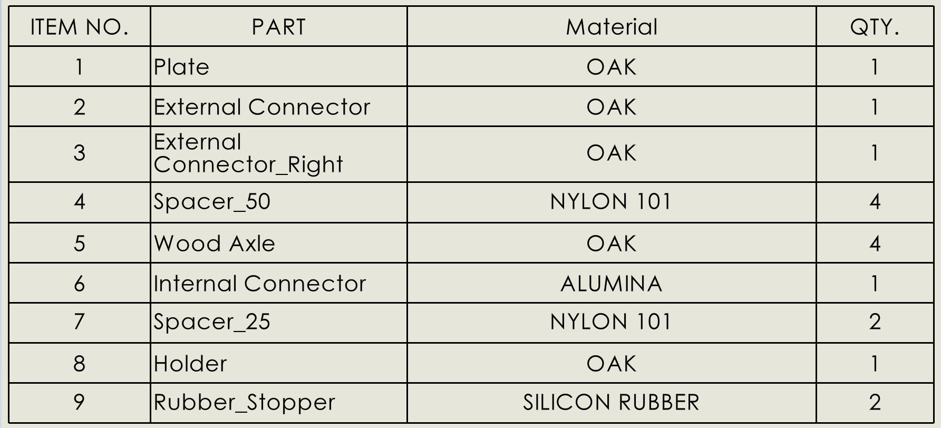
Final Design and Materials
Total Mass: 3.08 lbs
Notes:
Oak was chosen because it looks like a pretty strong material for wood
I also decided to make it work after looking at the TV Tray table and drafting table
Internal connector or leg was made out Alumina, which is a type of aluminia because I wanted to be lightweight and strong while having a smaller thickness than the external connectors or legs
Spacers used the design were made out of nylon because it looked like a common material used for plastic spacers
Black rubber stopper or grip on the holder plate is made of silicon rubber because its also a common material used

Slide 6
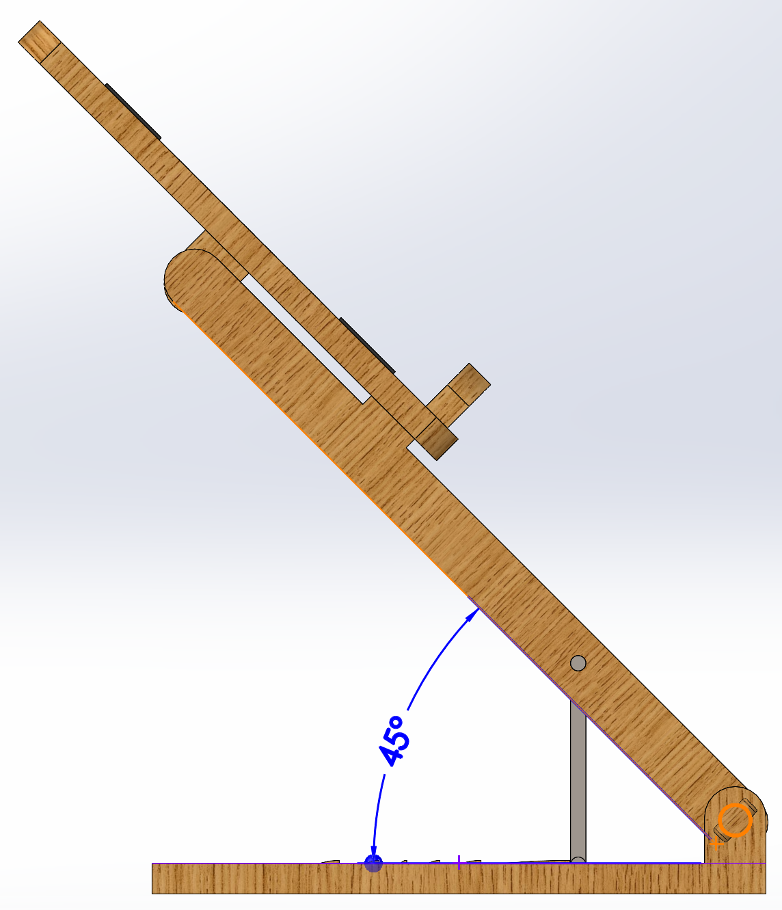
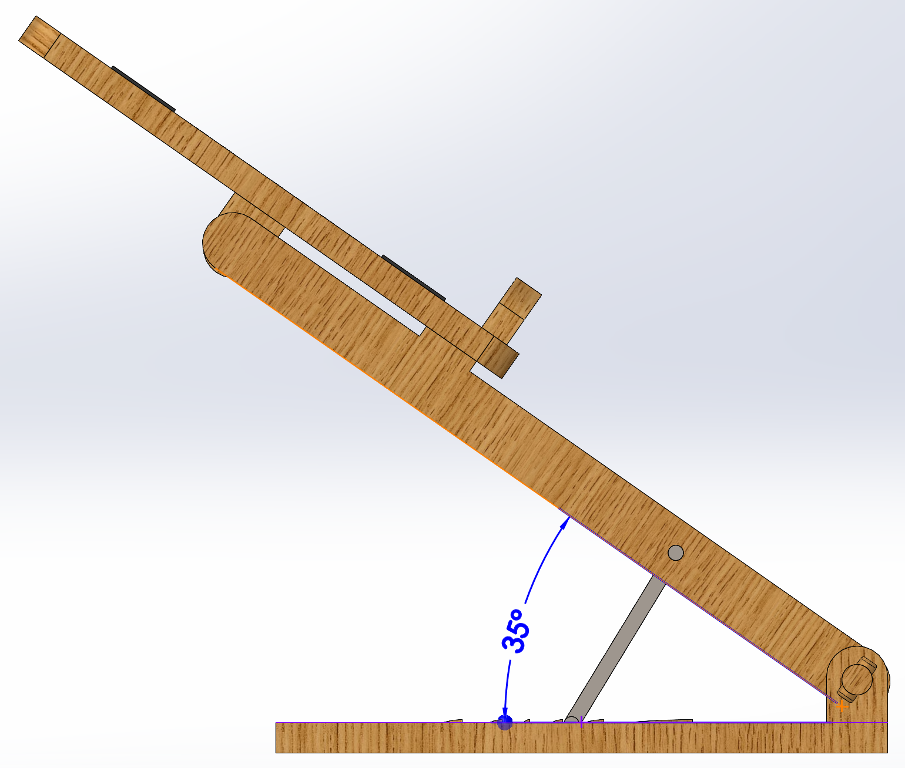
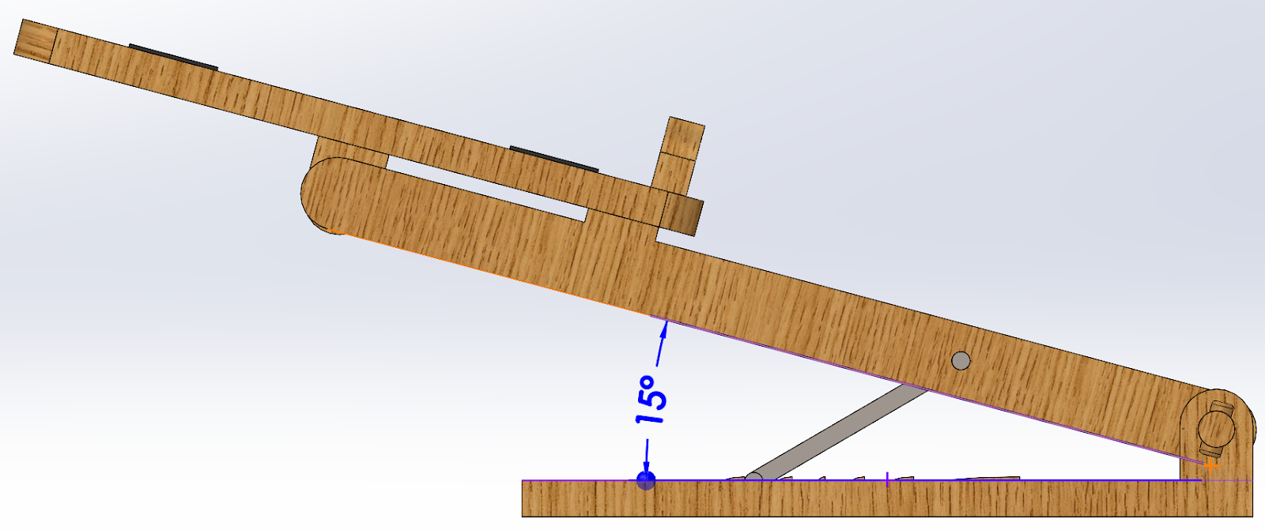
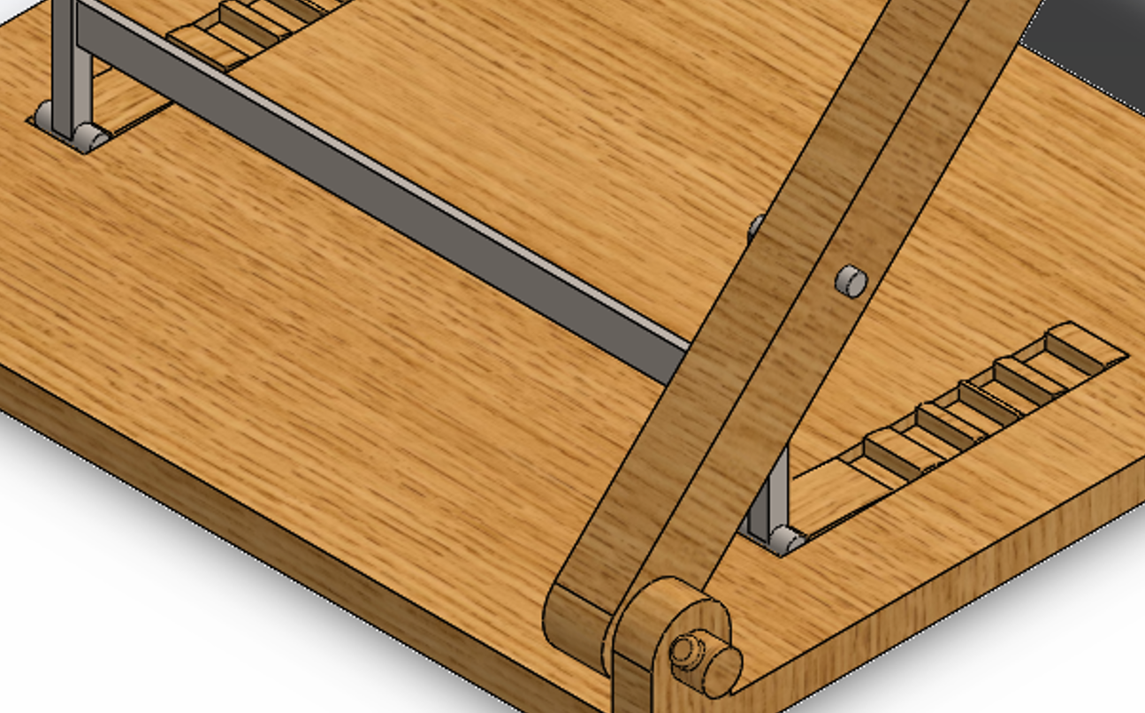
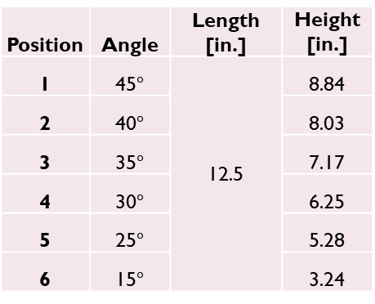
How it works
Position | Angle | Length [in.] | Height [in.]
1 | 45$°$ | 12.5 | 8.84
2 | 40$°$ |  | 8.03
3 | 35$°$ |  | 7.17
4 | 30$°$ |  | 6.25
5 | 25$°$ |  | 5.28
6 | 15$°$ |  | 3.24
Notes:
Throughout my research I created some pretty rough sketches of how I wanted to design the laptop stand
On the left side,
Top portion
Notice that I was originally thinking about taking a ratchet and using that as the connector
My main concern with this idea was if it was going to be stable enough to hold up the laptop without falling
Bottom portion
Starting to think about making gaps on the base plate and integrate the ratchet idea within the plate itself
Middle page
Left side
My initial ideas of using the TV Tray table
Problem was that the legs couldn’t be the same height, or else it wouldn’t really be adjusted.
Also, thought it wouldn’t be a good design
Right side
What I finally ended up going with as a design
It incorporates the ratchet and adjustable drafting table idea
Similar to drafting table in the sense that it had the teeth or gaps embedded within the design
Similar to ratchet in the sense that it had a small piece or component that adjusted the height by going into different gaps or teeth and was smaller than the other leg
Right side
Measurements that helped design the assembly
Also helped me envision it better by knowing how specific parts would look

Slide 7
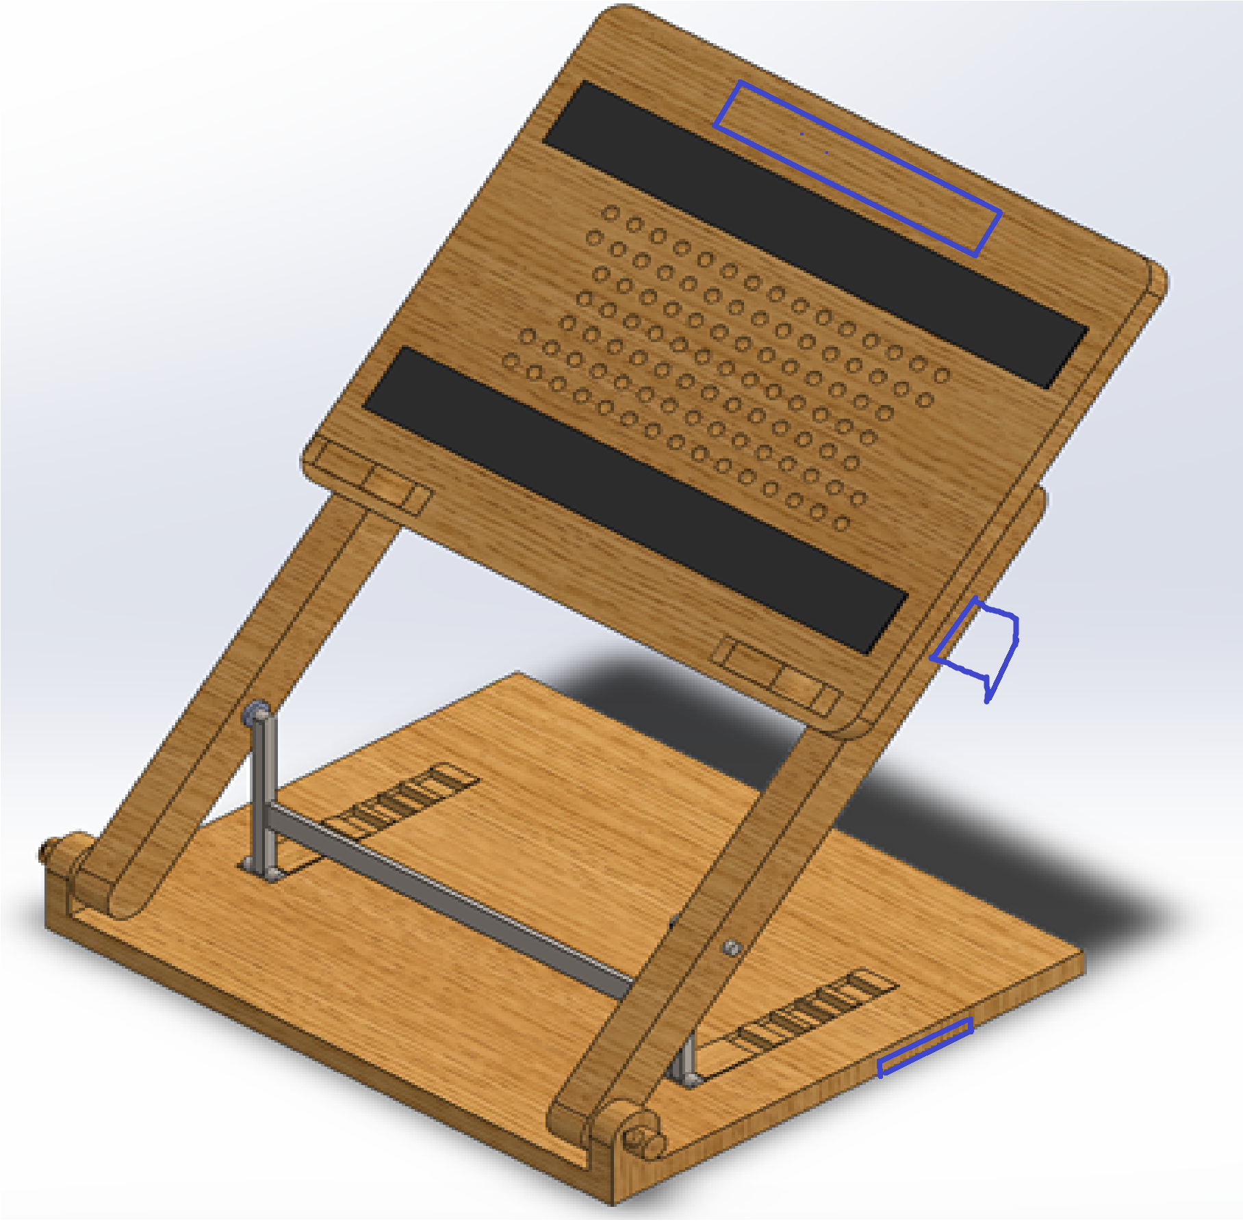
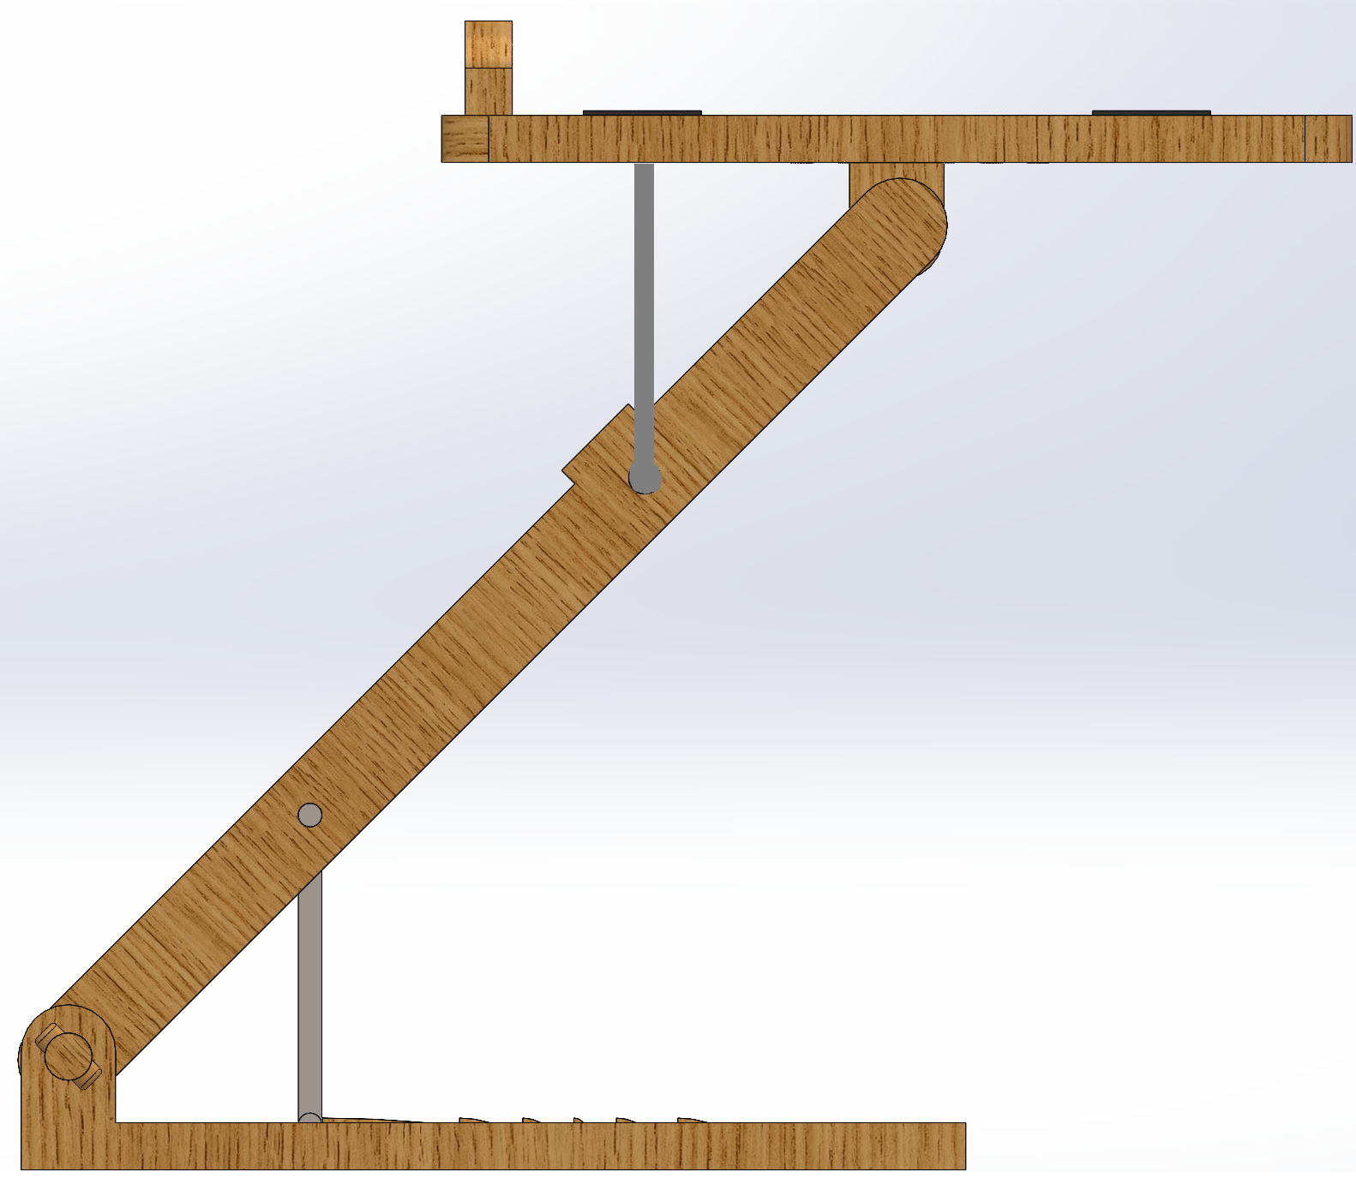
Improvements and Future Revisions
Adjustable height for Holder plate
Handle and lock
Notes:
1.)
Handle hole on the top and moving rubber grip to the sides
Something to hold the plate and external connectors on each side, so it would open up and move around
2.)
Similar to how the height is adjustable with the internal connector or leg
I can create another one to adjust the weight of the holder plate

